Slide 1

LECTURE 4: Use Cases
Liang Xiao

Slide 2
Topics
Actors, Goals
Sketchy/Summary Use Cases
Use Case Diagram
Traceability Matrix
System Boundary and Subsystems
Detailed Use Case Specification
System Sequence Diagrams
Security and Risk Management

Slide 3
Use Cases
For Functional Requirements Analysis and Specification
A use case is a description of how a user will use the system-to-be to accomplish business goals
  Detailed use cases are usually written as usage scenarios or scripts, listing a specific sequence of actions and interactions between the actors and the system
A use case is a usage scenario for an external entity, known as actor, and the system-to-be. A use case represents an activity that an actor can perform on the system and what the system does in response

Slide 4
Actors and their Goals
The consideration of system requirements starts with identifying the actors (e.g. a resident of home) for the system-to-be.
An actor is any entity (human, physical object, or another system) external to the system-to-be that interacts with the system-to-be.
  can be a person or
  another system
Actors have their responsibilities (e.g. maintain the home secured and in proper order) and seek the system’s assistance in managing those responsibilities.
To carry out its responsibilities, an actor sets goals (e.g. lock the door when leaving the apartment for work; open the door and enter the apartment when coming back), which are time and context-dependent.

Slide 5
Action
To achieve its goals, an actor performs some actions. An action is the triggering of an interaction with the system-to-be.
While preparing a response to the actor’s action, the system-to-be may need assistance from external entities other than the actor who initiated the process.
  a remote datacenter assists to successfully complete the use case “Withdraw Cash” for the system-to-be (ATM machine)
  that’s why there is a need to distinguish initiating actors and participating actors

Slide 6
Types of Actors
Initiating actor (also called primary actor or “user”): initiates the use case to realize a goal
Participating actor (also called secondary actor): participates in the use case but does not initiate it:
  Supporting actor: helps the system-to-be to complete the use case
  Offstage actor: passively participates in the use case, i.e., neither initiates nor helps complete the use case, but may be notified about some aspect of it (e.g., for keeping records)

Slide 7
Actors of the case study
We identify the following actors for secure home access:
Tenant is the home occupant
Landlord is the property owner or manager
Device is a physical device to be controlled by the system-to-be, such as lock-mechanism and light-switch, that are controlled by our system
Other potential actors: Maintenance, Police, etc.

Slide 8
An actor is associated with a role rather than with a person
A single person can appear as different actors, and different persons may play the same actor role

Slide 9
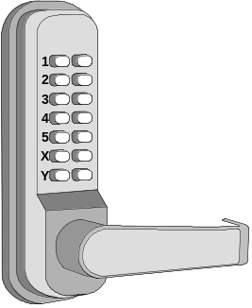
Deriving Use Cases from
System Requirements
REQ1: Keep door locked and auto-lock
REQ2: Lock when “LOCK” pressed
REQ3: Unlock when valid key provided
REQ4: Allow mistakes but prevent dictionary attacks
REQ5: Maintain a history log
REQ6: Adding/removing users at runtime
REQ7: Configuring the device activation preferences
REQ8: Inspecting the access history
REQ9: Filing inquiries
summary use cases are similar to user stories, they just identify the user’s role (actor type) and the capability that the system-to-be will provide (to assist in achieving the actor’s goals)
Actor | Actor’s Goal (what the actor intends to accomplish) | Use Case Name
Landlord | To disarm the lock and enter, and get space lighted up. | Unlock (UC-1)
Landlord | To lock the door & shut the lights (sometimes?). | Lock (UC-2)
Landlord | To create a new user account and allow access to home. | AddUser (UC-3)
Landlord | To retire an existing user account and disable access. | RemoveUser (UC-4)
Tenant | To find out who accessed the home in a given interval of time and potentially file complaints. | InspectAccessHistory (UC-5)
Tenant | To disarm the lock and enter, and get space lighted up. | Unlock (UC-1)
Tenant | To lock the door & shut the lights (sometimes?). | Lock (UC-2)
Tenant | To configure the device activation preferences. | SetDevicePrefs (UC-6)
LockDevice | To control the physical lock mechanism. | UC-1, UC-2
LightSwitch | To control the lightbulb. | UC-1, UC-2
[to be identified] | To auto-lock the door if it is left unlocked for a given interval of time. | AutoLock (UC-2)
( Actors already given if working from user stories instead of system requirements )

Slide 10
A yet-to-be-identified actor
[to be identified] | To auto-lock the door if it is left unlocked for a given interval of time. | AutoLock (UC-2)
Its goal is to automatically arm the lock after a certain period of time expires, to account for forgetful persons. Obviously, this is not a person’s goal, but neither is it the system’s goal because system-to-be does nothing on its own—it must receive an external stimulus to take action.

Slide 11
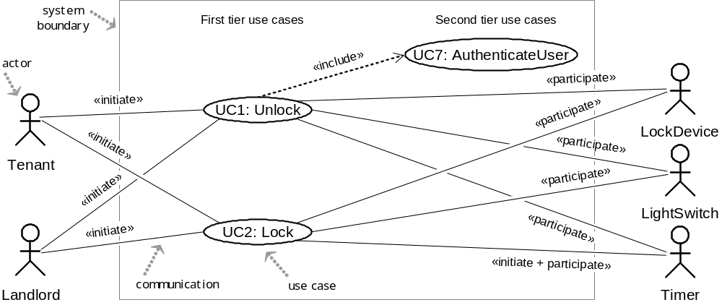
Use Case Diagram: Device Control
UC1: Unlock
UC2: Lock
UC3: AddUser
UC4: RemoveUser
UC5: InspectAccessHistory
UC6: SetDevicePrefs
UC7: AuthenticateUser
UC8: Login
Meaningful services provided by the system to an actor
Elaborations or sub-services of the main services (can be
reused in multiple locations)
Device Control Sub-system

Slide 12
UC7: AuthenticateUser
The AuthenticateUser use case is not a good candidate for first tier use cases, because it does not represent a meaningful stand-alone goal for an initiating actor.
It is, however, useful to show it explicitly as a second tier use case, particularly because it reveals which use cases require user authentication.
UC1: Unlock “include” UC7, while UC2: Lock does not “include” UC7. These design decisions, such as which use case does or does not require authentication, may need further consideration and justification, and can have serious consequences.

Slide 13
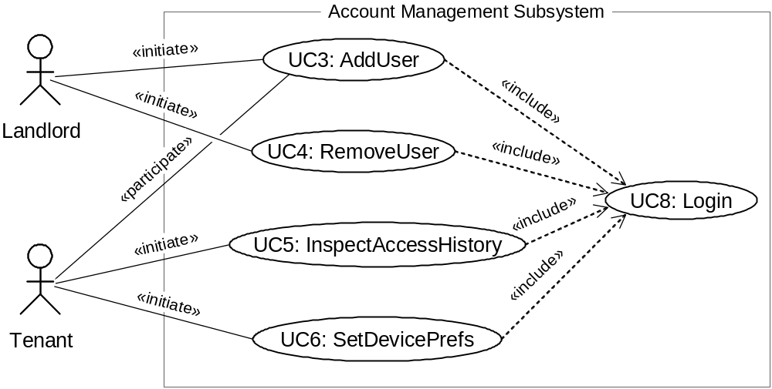
Use Case Diagram: Account Management
UC1: Unlock
UC2: Lock
UC3: AddUser
UC4: RemoveUser
UC5: InspectAccessHistory
UC6: SetDevicePrefs
UC7: AuthenticateUser
UC8: Login

Slide 14
Use Case Generalizations
Resident
ManageUsers
Tenant
Landlord
UC3: AddUser
UC4: RemoveUser
Actor Generalization
Use Case Generalization
Use cases that share common functionality can be abstracted in a more general, “base” use case

Slide 15
UC8: Login Use Case?
BAD:
GOOD:
Login
AddUser
AddUser
«include»
Login
Landlord
SetDevicePrefs
Landlord
SetDevicePrefs
«include»
A novice developer: user login is a use case. An expert developer: user login is not a use case.
A use case is motivated by user’s goal. The user initiates interaction with the system to achieve a certain goal.
You are not logging in for the sake of logging in—you are logging in to do some work, and this work is your use case.

Slide 16
Two stereotypes of relationship of use cases
<<include>> – required subtasks of the main case
<<extend>> – optional extensions of the main case
  If a user’s goal has several subgoals, some of which are optional, we can indicate this information in a use case diagram using the <<extend>> stereotype.

Slide 17
Optional Use Cases: «extend»
Example optional use cases:
We may design a use case to allow the user to manage his account. As part of account management, optional activities that may or may not take place are the inspection of access history and configuring the device-activation preferences.
UC5: InspectAccessHistory
«extend»
ManageAccount
«extend»
UC6: SetDevicePrefs
Key differences between «include» and «extend» relationships
Included use case
Extending use case
Is this use case optional?
No
Yes
Is the base use case complete without this use case?
No
Yes
Is the execution of this use case conditional?
No
Yes
Does this use case change the behavior of the base use case?
No
Yes
[ Source: Robert Maksimchuk & Eric Naiburg: UML for Mere Mortals, Addison-Wesley, 2005. ]

Slide 18
Use case diagram = use case?
Device Control Sub-system

Slide 19
Use case diagram ≠ use case!
An analogy: A diagram provides a useful overview index of a book, but the actual use cases (contents) represent the book’s main value and you need them to understand what the system does or is supposed to do.
Device Control Sub-system
The diagram serves only to capture an overview of the system services (features) in a concise visual form without detailing how each service (feature) should operate.
Use cases are text stories that detail exactly what happens when an actor attempts to obtain a service from the system.

Slide 20
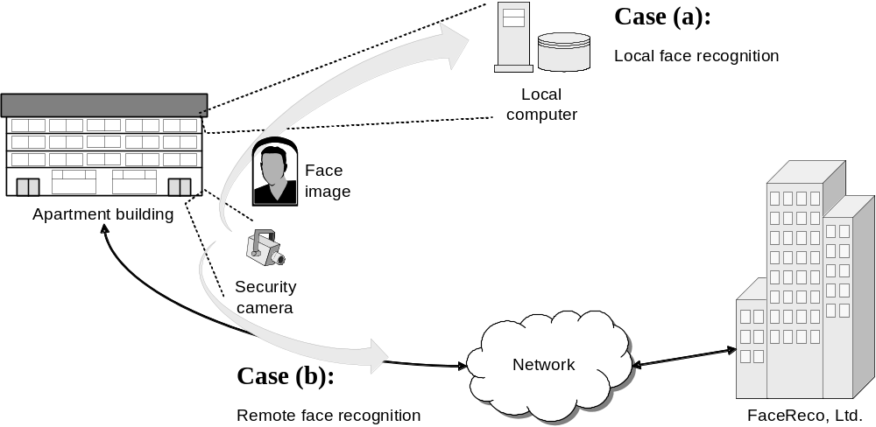
System Boundary & Subsystems
Alternative cases of face recognition for secure home access system
Use Case Variations Example:
shifted from a
single-family home

Slide 21
Two variations of solutions
Case (a): You procure face recognition software, install it on your local computer, and link it up with a standard relational/SQL database for memorizing the faces of legitimate users.
Case (b): After a preliminary study, you find that maintaining the database of legitimate faces, along with training the recognition system on new faces and unlearning the faces of departed residents, are overly complex and costly. You decide that the face recognition processing should be outsourced to a specialized security company, FaceReco, Ltd. This company specializes in user authentication, but they do not provide any application specific services. Thus, you still need to develop the rest of the access control system.

Slide 22
New actor identification
Are the new tools (face recognition software and relational database) new actors or they are part of the system and should not be distinguished from the system?

Slide 23
New actor identification
In case (a), they are not worth distinguishing, they are just modules that provide data-storage and user-authentication, so they are part of the planned system.
Most importantly, they are under our control, so there is nothing special about them as opposed to any other module of the planned system.
The use case diagrams remain the same.

Slide 24
New actor identification
For case (b), we need to distinguish a new actor: the FaceReco Company, which provides authentication services.
There is a need-to-know that they are part of the process of fulfilling some goal(s) of initiating actors.
A new actor: FaceReco needs to be included in a modified use case diagram.

Slide 25
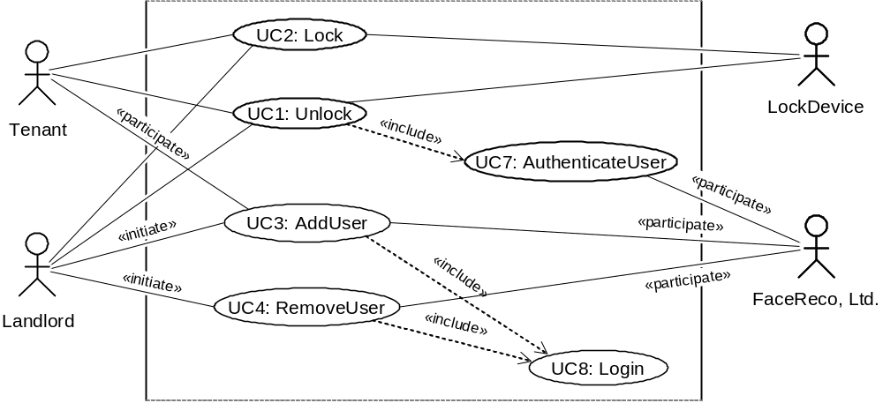
Modified Use Case Diagram
UC1: Unlock
UC2: Lock
UC3: AddUser
UC4: RemoveUser
UC5: InspectAccessHistory
UC6: SetDevicePrefs
UC7: AuthenticateUser
UC8: Login
Authentication subsystem (FaceReco, Ltd.)
is externalized from the system-to-be:

Slide 26
Difference of UC7 & UC8?
In UC-3 & UC-4 we include the subordinate use case Login (UC-8), which is not the same as AuthenticateUser, numbered UC-7.
The reason is that UC-7 is designed to authenticate persons at the entrance(s).
Conversely, user management is always done from the central computer, so we need to design an entirely different use case.

Slide 27
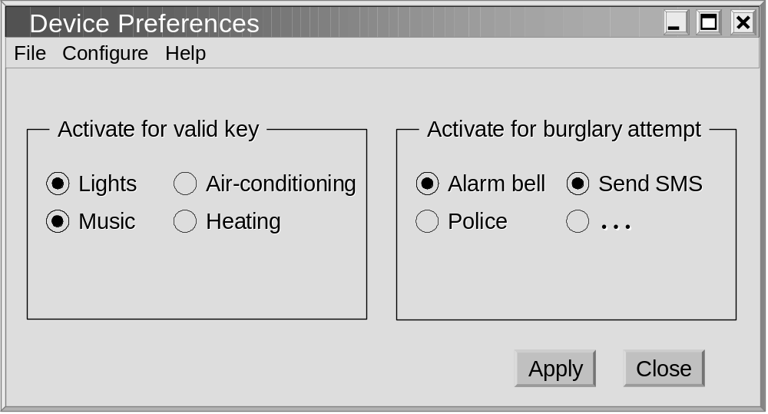
GUI for UC6: Set Device Pref’s
( NOTE: Lock device is mandatory )

Slide 28
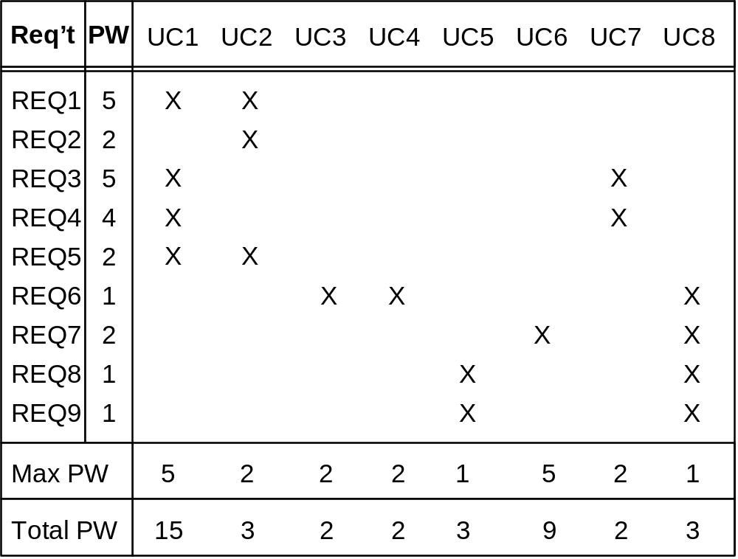
Traceability Matrix (1)
Mapping: System requirements to Use cases
UC1: Unlock
UC2: Lock
UC3: AddUser
UC4: RemoveUser
UC5: InspectAccessHistory
UC6: SetDevicePrefs
UC7: AuthenticateUser
UC8: Login
REQ1: Keep door locked and auto-lock
REQ2: Lock when “LOCK” pressed
REQ3: Unlock when valid key provided
REQ4: Allow mistakes but prevent dictionary attacks
REQ5: Maintain a history log
REQ6: Adding/removing users at runtime
REQ7: Configuring the device activation preferences
REQ8: Inspecting the access history
REQ9: Filing inquiries
Purpose: to check that all requirements are covered by the use cases and none of the use cases is created without a reason
If a use case is derived from a requirement, then the corresponding entry in the matrix is checked
The Max PW (priority weight) row shows the maximum priority of any checked requirement in the column
above.
The bottom row shows the Total PW of each use case obtained by summing up the priorities of the checked requirements in the column above.
Continued for domain model, design diagrams, …

Slide 29
Traceability Matrix Purpose
To check that all requirements are covered by the use cases
To check that none of the use cases is introduced without a reason (i.e., created not in response to any requirement)
To prioritize the work on use cases

Slide 30
Detailed Use Case Specification
A detailed use case description represents a use case of the system as a sequence of interactions between external entities (actors) and the system-to-be, usually written as usage scenarios.
A scenario describes in a step-by-step manner activities that an actor does and how the system responds, also called a use case instance, representing only one of several possible courses of action for a given use case.

Slide 31

Detailed Use Case Specification
We usually first elaborate the “normal” scenario, also called main success scenario, which assumes that everything goes perfect, with no conditions or branching—it flows linearly.
Alternate scenarios or extensions
  Inappropriate data entry
  System’s inability to respond as desired
Attempt to burglarize a home may be a self-contained and meaningful goal for certain types of system users
  This must be anticipated and treated as an exception to a legal use case - “abuse cases”

Slide 32
Schema for Detailed Use Cases
Use Case UC-#: |  |  |  | Name / Identifier [verb phrase]
Related Requirements: |  |  |  | List of the requirements that are addressed by this use case
Initiating Actor: |  |  |  | Actor who initiates interaction with the system to accomplish a goal
Actor’s Goal: |  |  |  | Informal description of the initiating actor’s goal
Participating Actors: |  |  |  | Actors that will help achieve the goal or need to know about the outcome
Preconditions: |  |  |  | What is assumed about the state of the system before the interaction starts
Postconditions: |  |  |  | What are the results after the goal is achieved or abandoned; i.e., what must be true about the system at the time the execution of this use case is completed
Flow of Events for Main Success Scenario:
→ | 1. | The initiating actor delivers an action or stimulus to the system (the arrow indicates the direction of interaction, to- or from the system)
← | 2. | The system’s reaction or response to the stimulus; the system can also send a message to a participating actor, if any
→ | 3. | …
Flow of Events for Extensions (Alternate Scenarios): What could go wrong? List the exceptions to the routine and describe how they are handled
→ | 1a. | For example, actor enters invalid data
← | 2a. | For example, power outage, network failure, or requested data unavailable
 |  | …
The arrows on the left indicate the direction of interaction: → Actor’s action; ← System’s reaction

Slide 33
Observations
Use cases are not specific to the object-oriented software engineering – they are process-oriented rather than object-oriented on the description of activities.
We see the system as a “black box” and focus on the interaction protocol between the actor(s) and the black box. Only at the stage of building the domain model we encounter objects, which populate the black box.

Slide 34
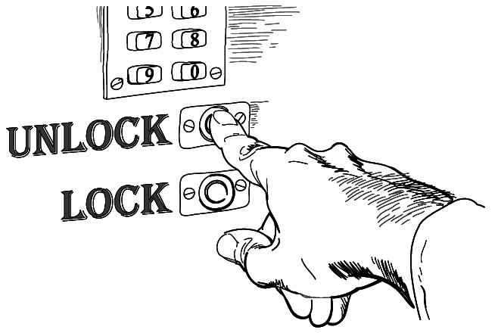
Use Case 1: Unlock
Use Case UC-1: |  |  | Unlock
Related Requirements: |  |  | REQ1, REQ3, REQ4, and REQ5 stated in Table 2-1
Initiating Actor: |  |  | Any of: Tenant, Landlord
Actor’s Goal: |  |  | To disarm the lock and enter, and get space lighted up automatically.
Participating Actors: |  |  | LockDevice, LightSwitch, Timer
Preconditions: |  |  | • The set of valid keys stored in the system database is non-empty. • The system displays the menu of available functions; at the door keypad the menu choices are “Lock” and “Unlock.”
Postconditions: |  |  | The auto-lock timer has started countdown from autoLockInterval.
Flow of Events for Main Success Scenario:
→ | 1. | Tenant/Landlord arrives at the door and selects the menu item “Unlock”
 | 2. | include::AuthenticateUser (UC-7)
← | 3. | System (a) signals to the Tenant/Landlord the lock status, e.g., “disarmed,” (b) signals to LockDevice to disarm the lock, and (c) signals to LightSwitch to turn the light on
← | 4. | System signals to the Timer to start the auto-lock timer countdown
→ | 5. | Tenant/Landlord opens the door, enters the home [and shuts the door and locks]
This is covered under the use case Lock, and does not concern this use case

Slide 35
Subroutine «include» Use Case
Use Case UC-7: |  |  |  | AuthenticateUser (sub-use case)
Related Requirements: |  |  |  | REQ3, REQ4 stated in Table 2‑1
Initiating Actor: |  |  |  | Any of: Tenant, Landlord
Actor’s Goal: |  |  |  | To be positively identified by the system (at the door interface).
Participating Actors: |  |  |  | AlarmBell, Police
Preconditions: |  |  |  | • The set of valid keys stored in the system database is non-empty. • The counter of authentication attempts equals zero.
Postconditions: |  |  |  | None worth mentioning.
Flow of Events for Main Success Scenario:
← | 1. | System prompts the actor for identification, e.g., alphanumeric key
→ | 2. | Tenant/Landlord supplies a valid identification key
← | 3. | System (a) verifies that the key is valid, and (b) signals to the actor the key validity
Flow of Events for Extensions (Alternate Scenarios):
2a. Tenant/Landlord enters an invalid identification key
← | 1. | System (a) detects error, (b) marks a failed attempt, and (c) signals to the actor
← |  | 1a. | System (a) detects that the count of failed attempts exceeds the maximum allowed number, (b) signals to sound AlarmBell, and (c) notifies the Police actor of a possible break-in
→ | 2. | Tenant/Landlord supplies a valid identification key
 | 3. | Same as in Step 3 above

Slide 36
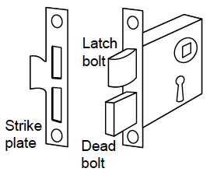
Focus on the essential when writing a usage scenario
→ | 2. | Tenant/Landlord supplies a valid identification key
Focus on the “what” and leave out the “how” for the subsequent stages of the development lifecycle.
Just state that the user should provide identification - Do not detail whether this is done by typing on a keypad, by scanning an RFID tag, or by some biometric technology.

Slide 37
User acceptance test case
At the time of writing detailed use cases, we also write (customer should help) the corresponding user acceptance tests.
In the context of use cases, a user acceptance test case is a detailed procedure that fully tests a use case or one of its flows of events.
The focus is on what the user does - the test cases must be designed around the actual tasks that the user will need to perform.
Because by now we have elaborated step-by-step scenarios for use cases, we are able to provide not just the input data and expected outcomes, but more details for pass and fail conditions.

Slide 38
Acceptance Test Case for
UC-7 Authenticate User
Test-case Identifier: | TC-1
Use Case Tested: | UC-1, main success scenario, and UC-7
Pass/fail Criteria: | The test passes if the user enters a key that is contained in the database, with less than a maximum allowed number of unsuccessful attempts
Input Data: | Numeric keycode, door identifier
Test Procedure: |  | Expected Result:
Step 1. Type in an incorrect keycode and a valid door identifier |  | System beeps to indicate failure; records unsuccessful attempt in the database; prompts the user to try again
Step 2. Type in the correct keycode and door identifier |  | System flashes a green light to indicate success; records successful access in the database; disarms the lock device

Slide 39
An acceptance test needs to convince the customer that the system works as expected

Slide 40
Use Case 2: Lock
Use Case UC-2: |  |  | Lock
Related Requirements: |  |  | REQ1, REQ2, and REQ5 stated in Table 2-1
Initiating Actor: |  |  | Any of: Tenant, Landlord, or Timer
Actor’s Goal: |  |  | To lock the door & get the lights shut automatically (?)
Participating Actors: |  |  | LockDevice, LightSwitch, Timer
Preconditions: |  |  | The system always displays the menu of available functions.
Postconditions: |  |  | The door is closed and lock armed & the auto-lock timer is reset.
Flow of Events for Main Success Scenario:
→ | 1. | Tenant/Landlord selects the menu item “Lock”
← | 2. | System (a) signals affirmation, e.g., “lock armed,” (b) signals to LockDevice to arm the lock (if not already armed), (c) signal to Timer to reset the auto-lock counter, and (d) signals to LightSwitch to turn the light off (?)
Flow of Events for Extensions (Alternate Scenarios):
2a. System senses that the door is not closed, so the lock cannot be armed
← | 1. | System (a) signals a warning that the door is open, and (b) signal to Timer to start the alarm counter
→ | 2. | Tenant/Landlord closes the door
← | 3. | System (a) senses the closure, (b) signals affirmation to the Tenant/Landlord, (c) signals to LockDevice to arm the lock, (d) signal to Timer to reset the auto-lock counter, and (e) signal to Timer to reset the alarm counter

Slide 41
The auto-lock timer
The auto-lock timer appears as both the initiating and participating actor. This is because if the timeout time expires before the timer is reset, Timer automatically initiates the Lock use case, so it is an initiating actor. Alternatively, if the user locks the door before the timeout expires, the timer will be reset, so it is an offstage actor, as well.

Slide 42
Why not just say that the system will somehow handle the auto-lock functionality rather than going into the details of how it works?
Technically, the timer is part of the system-to-be, so why should it be declared an external actor?!
Recall that the system is always passive—it reacts to an external stimulus but does nothing on its own initiative. Thus, to get the system perform auto-lock, somebody or something must trigger it to do so. This is the responsibility of Timer. Timer is an external stimulus source relative to the software under development, although it will be part of the end hardware-plus-software system.

Slide 43
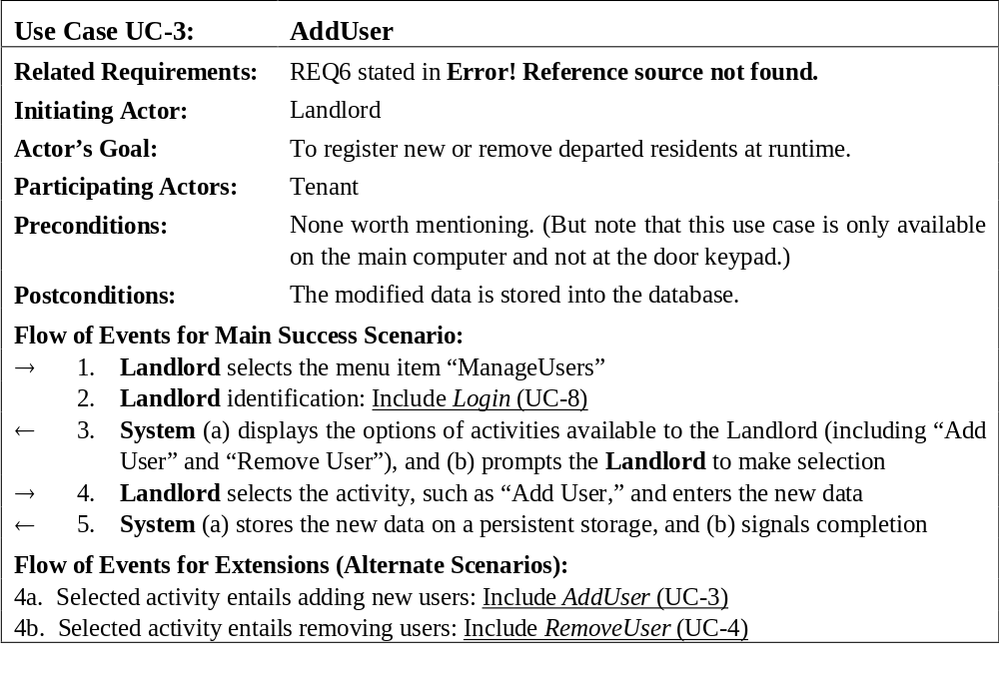
Use Case 3: Add User

Slide 44
Use Case 5: Inspect Access History
Use Case UC-5: |  |  | Inspect Access History
Related Requirements: |  |  | REQ8 and REQ9 stated in Table 2-1
Initiating Actor: |  |  | Any of: Tenant, Landlord
Actor’s Goal: |  |  | To examine the access history for a particular door.
Participating Actors: |  |  | Database, Landlord
Preconditions: |  |  | Tenant/Landlord is logged in the system and is shown a hyperlink “View Access History.”
Postconditions: |  |  | None.
Flow of Events for Main Success Scenario:
→ | 1. | Tenant/Landlord clicks the hyperlink “View Access History”
← | 2. | System prompts for the search criteria (e.g., time frame, door location, actor role, event type, etc.) or “Show all”
→ | 3. | Tenant/Landlord specifies the search criteria and submits
← | 4. | System prepares a database query that best matches the actor’s search criteria and retrieves the records from the Database
→ | 5. | Database returns the matching records
← | 6. | System (a) additionally filters the retrieved records to match the actor’s search criteria; (b) renders the remaining records for display; and (c) shows the result for Tenant/Landlord’s consideration
→ | 7. | Tenant/Landlord browses, selects “interesting” records (if any), and requests further investigation (with an accompanying complaint description)
← | 8. | System (a) displays only the selected records and confirms the request; (b) archives the request in the Database and assigns it a tracking number; (c) notifies Landlord about the request; and (d) informs Tenant/Landlord about the tracking number

Slide 45
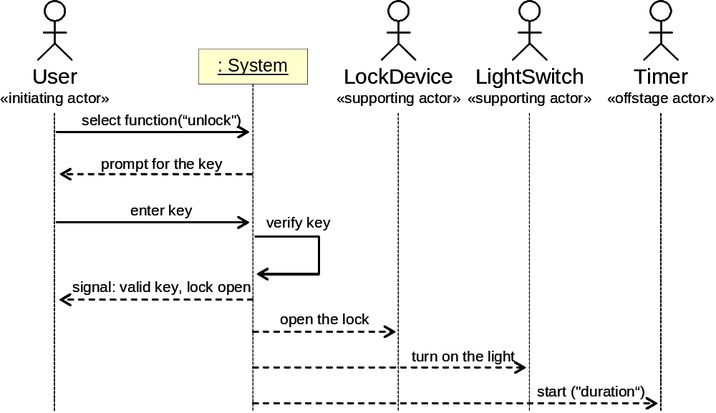
System Sequence Diagram
[Modeling System Workflows]
Use case: Unlock
A system sequence diagram represents in a visual form a usage scenario that an actor experiences while trying to obtain a service from the system
Main success scenario
Similar to UML sequence diagrams,
but for actor interactions instead of software object interactions

Slide 46
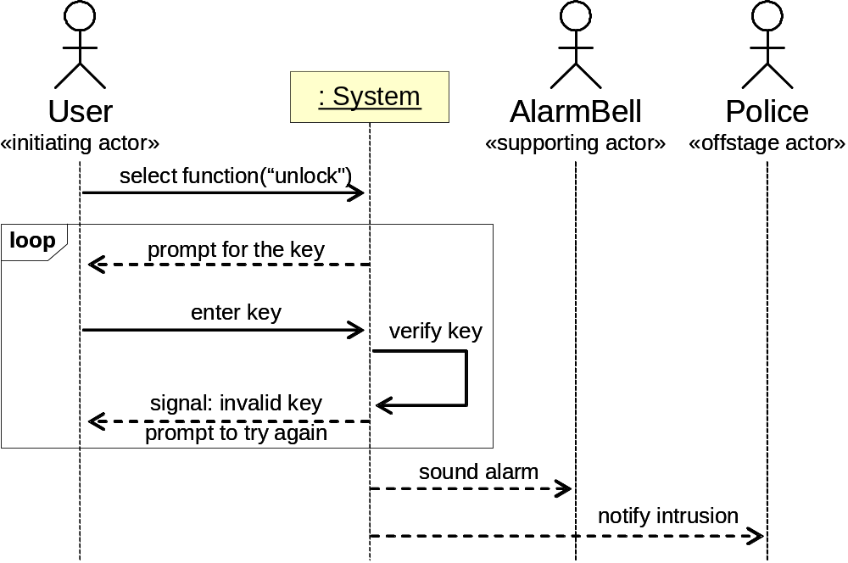
System Sequence Diagram
[Modeling System Workflows]
Use case: Unlock
The UML “loop” interaction frame delineates a fragment that may execute multiple times
Alternate scenario (burglary attempt)

Slide 47
System Sequence Diagram
[Modeling System Workflows]
The key purpose of system sequence diagrams is to represent what information must pass the system boundary and in what sequence. Therefore, a system sequence diagram can contain only a single box, named System, in the top row, which is our system-to-be. All other entities must be actors.

Slide 48
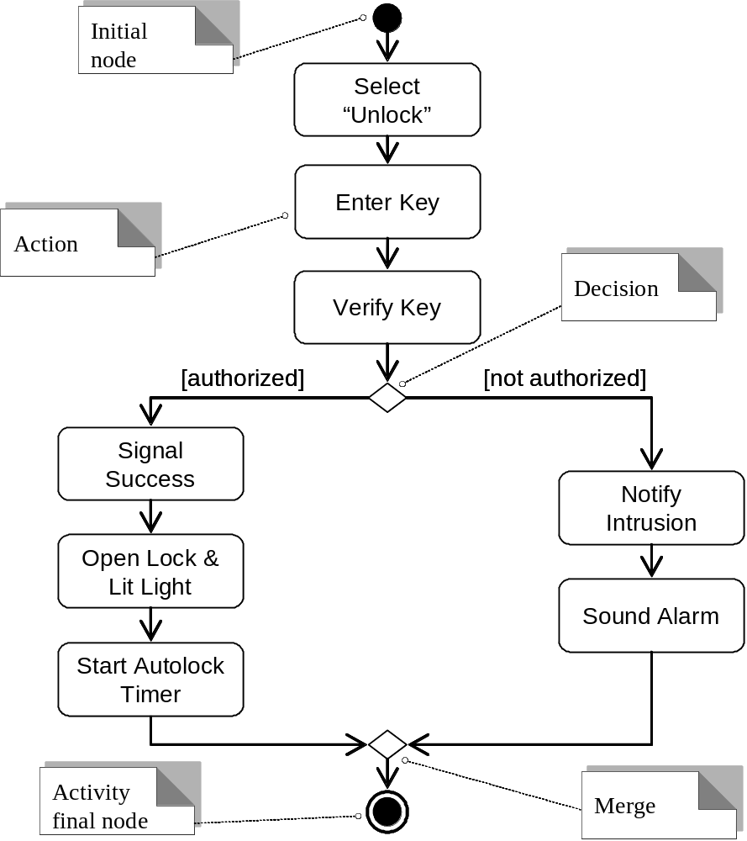
Activity Diagram
[Modeling System Workflows]

Slide 49
Use Cases for Requirements Engineering
In general, the use case approach is best suited for the reactive and interactive systems. However, they do not adequately capture activities for systems that are heavily algorithm-driven, such as the virtual biology lab and financial markets simulation, or data-intensive, such as databases or large data collections

Slide 50
Software defects often result from misunderstanding the requirements, not only because of inadequate developmental skills.

Slide 51
We usually know only approximately what we are to
do. But, a general understanding of the problem is not
enough for success. We must know exactly what to do
because programming does not admit vagueness.
Requirements provide a vital linkage to ensure that teams deliver systems that solve real business problems. You need to ensure that you “do the right thing the right way.”
When faced with a difficult decision, it is a good idea to ask the customer for help. After all, the customer can judge best what solution will work best for him and he will easier accept
compromises if they were involved in making them.
  restaurant automation project vs. stock investment fantasy league

Slide 52
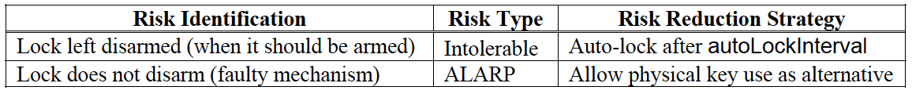
Security and Risk Management
Identifying and preempting the serious risks to system’s safe and successful functioning
Risk types:
  Intolerable
  As low as reasonably practical (ALARP)
  Acceptable

Slide 53
Security and Risk Management
A risk condition capturing the situation upon which the risk of a given fault may occur.
A fault in a business process is an undesired state of a process instance which may lead to a process failure.
Identifying a fault in a process requires determining the condition upon which the fault occurs.
If a risk is detected during requirements analysis, remedial actions should be taken to rectify the use case design and prevent an undesired state of the business process (fault for short), from occurring.

Slide 54

Security and Risk Management
Risk analysis involves more than just considering “what could go wrong” in different steps of use-case scenarios. It is possible that each step is executed correctly, but system as a whole fails. Such scenarios represent misuse cases / abuse case.
An important requirement for our safe-home-access system is to prevent dictionary attacks (REQ4). We need to count the unsuccessful attempts, but also need to reset the counter if the user leaves before providing a valid key or reaching the maximum allowed number of unsuccessful attempts. To detect such situations, the system may run a timer for maxAttemptPeriod duration and then reset the counter of unsuccessful attempts.
Example abuse case input sequence:
    invalid-key, invalid-key, … ≤ maxNumOfAttempts ;
    wait maxAttemptPeriod ; invalid-key, invalid-key, …

